Slide 1
Domestic Violence and Eviction Summit
Collaboration between Creighton, UNO, and Juvenile Justice Institute
Pierce Greenberg – Creighton University Tara Richards – UNO Criminal Justice
Michelle Roley-Roberts – Creighton University Anne Hobbs – Juvenile Justice Institute
Graduate Student Researchers: Michaela Goldsmith and Brian Gildea
Undergraduate Student Researchers: Gelsey Timilsina, Nora Martin, Monica Bradley

Slide 2
Today’s Plan
Get Lunch
Research Presentation
Group Discussion and Brainstorming Activity on Domestic Violence and Housing Insecurity Overlap in Omaha

Slide 3



Who are we?
Grant studying the link between traumatic events like domestic violence and eviction in Omaha.
Providing data to examine that link.
Hosting community summit, sharing results, starting discussion.

Slide 4
What we’ll discuss today
The state of housing insecurity in Omaha.
How domestic violence can be a cause/consequence of housing insecurity.
Our research methods and results.
Where do we go from here?

Slide 5
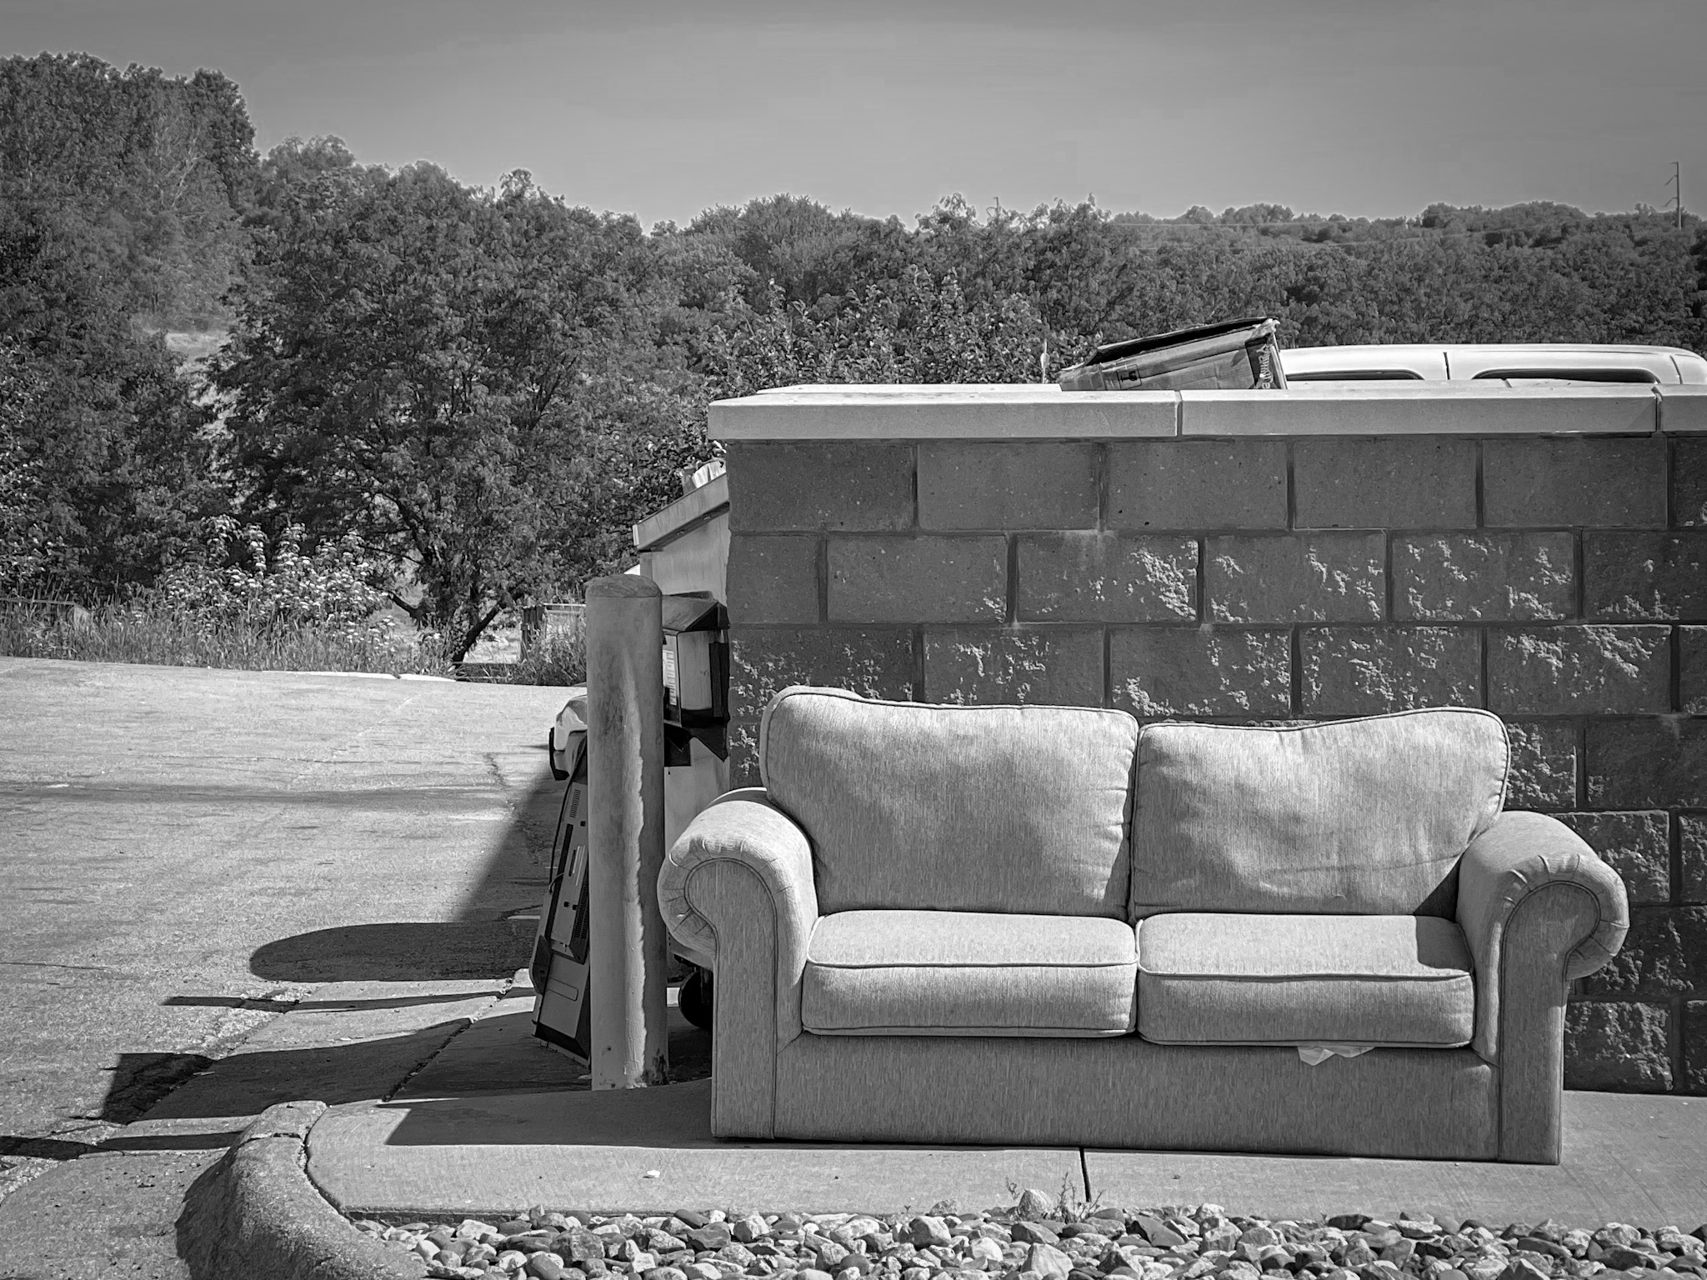
Why is housing stability important?
Residential stability is core to other forms of stability.
It is a neighborhood and community issue, in addition to an individual problem.
Photo by Eric Meyer

Slide 6
Housing Insecurity in Omaha
From 2012 to 2019, Omaha had more than 3,500 evictions, on average, per year.
Since COVID, yearly eviction totals have declined due to supports:
  Federal and local eviction moratoriums
  Emergency Rental Assistance Program
  Tenant supports from Legal Aid of Nebraska and theTenant Assistance Project

Slide 7
ERAP Distribution in Omaha
From April 2021 to April 2022, more than 7,400 households in Omaha received emergency rental assistance (for rent).
99.1% of rental assistance goes directly to landlords.
The average assistance was ~$4,000.
Average length was ~4 months.
Average rent for ERA: $1,035.

Slide 8
What kind of households received ERAP?
56% of ERAP households made less than 30% of the median household income. (~$18,000 for 1 person HH).
27%: households made between 30% and 50% of median area income (~$18,000 to $30,000).
$1,035/month is well above affordability for people making these incomes (Omaha Community Foundation report).

Slide 9
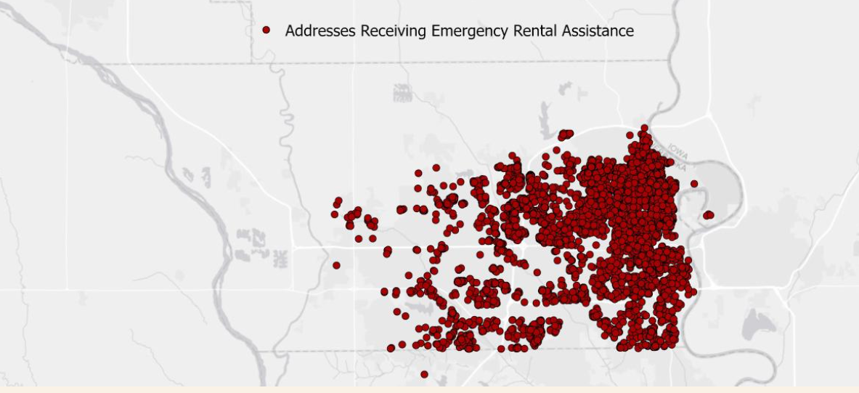
Mapping ERAP Distribution

Slide 10
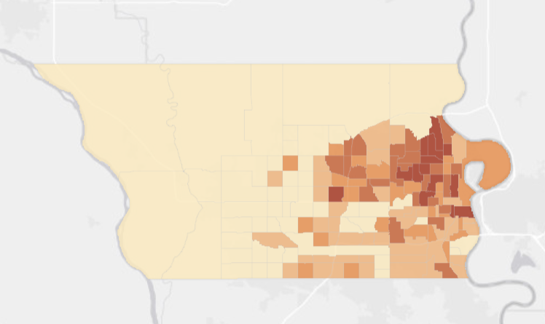
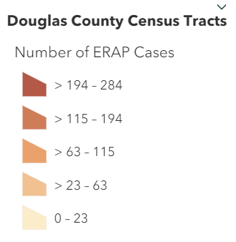
Mapping ERAP Distribution

Slide 11
Gaps in ERAP Distribution
Statistical analysis finds South Omaha receiving less ERA than expected based on demographics (i.e., renter households, etc.)
Note: citizenship requirement imposed by city of Omaha due to state law prohibiting public assistance to non-citizens.

Slide 12
Overall State of Housing Insecurity in Omaha
Programs such as the Emergency Rental Assistance Program have been very effective…
But at the same time highlight the very high level of need in our community.

Slide 13
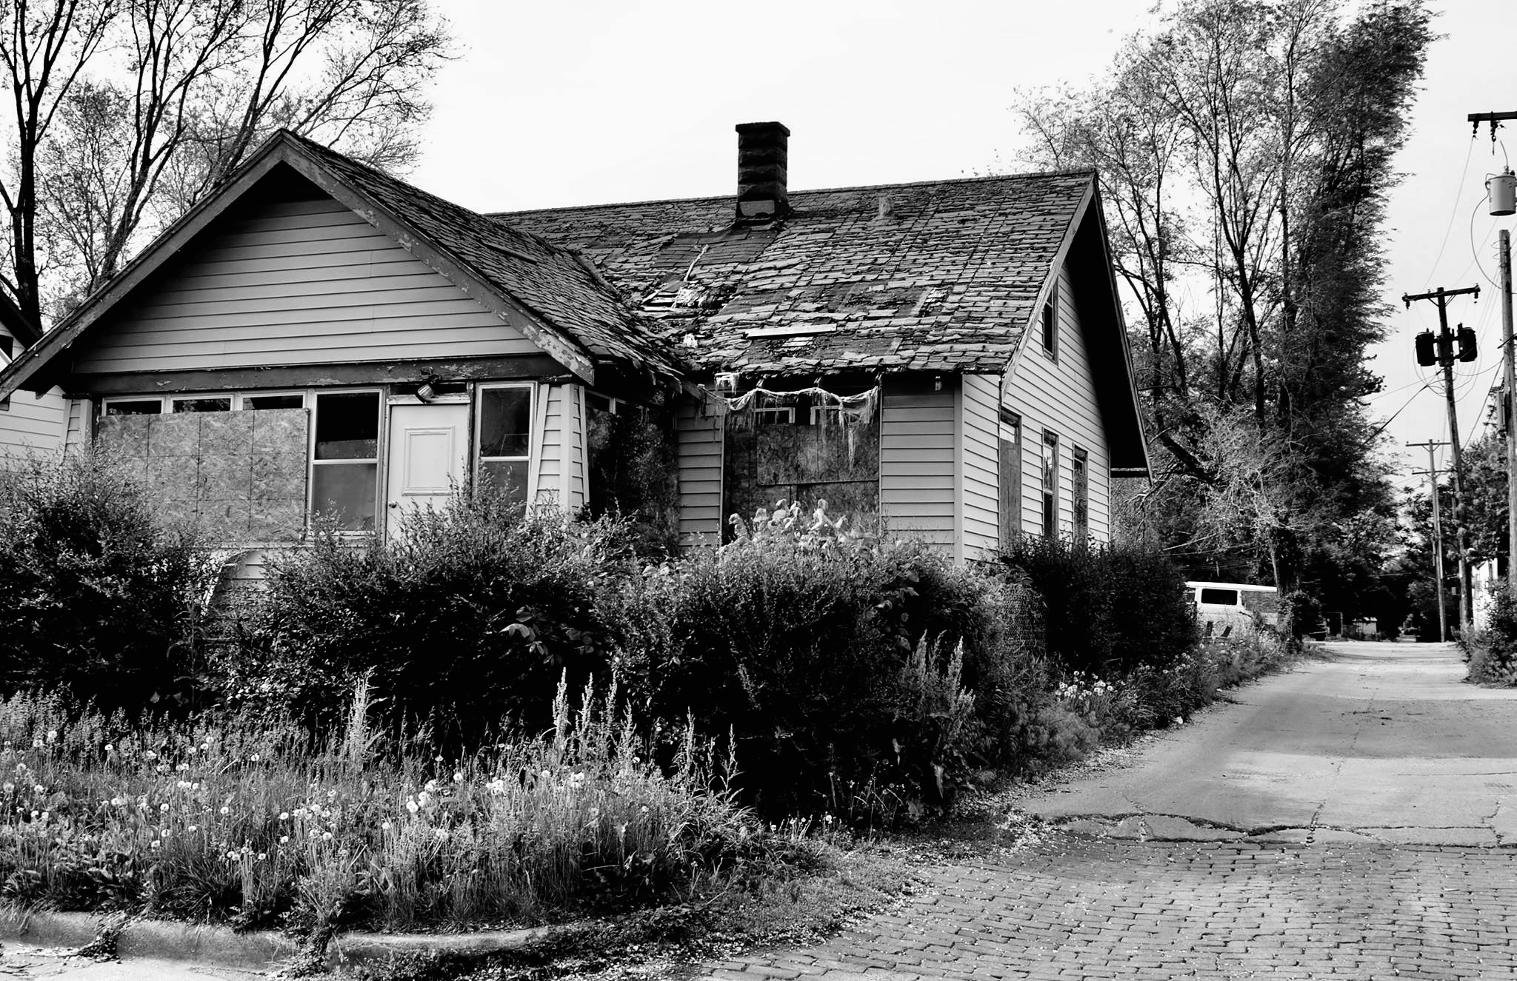
The link between DV and housing insecurity
Both can be considered traumatic events that influence life outcomes: social, physical, and mental health.
Residential instability can cause domestic violence issues; domestic violence can lead to residential instability.

Slide 14
Traumatic Event History and Risk for Negative Outcomes Like Homelessness
History of childhood traumatic events and adverse childhood experiences increases risk for a wide variety of negative outcomes with a dose-response effect^{1,10} including:
  Additional traumatic events in adulthood²
  Mental health disorders^{9,13}
  Non-suicidal self-injury²
  Suicide ideation and attempts²
  Homelessness³
  Incarceration¹⁴
  Chronic health conditions –
    Obesity^{4,5}, heart disease^{6,9,10}, cancer^{7,9,10}, chronic lung disease^{7,8,9}, stroke^{9,10}, Alzheimer's disease^{9,10}, diabetes^{9,10}, chronic kidney disease^{9,10}, autoimmune disorders¹¹
  Life expectancy¹²
Hughes et al., 2017; 2. Roley-Roberts et al., 2017; 3. Roos et al., 2013; 4. Mason et al., 2016; 5. Danese & Tan, 2014; 6. Su et al., 2015; 7. Brown et al., 2010;
8. Anda et al., 2008; 9. Lin et al., 2021; 10. Holter et al., 2020; 11. Dube et al., 2009; 12. Brown et al., 2009; 13. Lee et al., 2020; 14. Roos et al., 2016
Notes:
(e.g., physical abuse, neglect, sexual abuse, domestic violence, experience with a family member with mental health difficulties, disruptions in primary relationships due to incarceration)
Brown et al 2009 found a 20-year difference in life expectancy when comparing a sample of adults with childhood adverse experiences to a sample of adults without childhood adverse experiences.
Mason SM, Bryn Austin S, Bakalar JL, Boynton-Jarrett R, Field AE, Gooding HC, Holsen LM, Jackson B, Neumark-Sztainer D, Sanchez M, Sogg S, Tanofsky-Kraff M, Rich-Edwards JW. Child maltreatment’s heavy toll: the need for trauma-informed obesity prevention. Am J Prev Med. 2016;50(5):646–9. Epub 2015 Dec 11. PubMed PMID: 26689978; PubMed Central PMCID: PMC4905569. https://doi.org/10.1016/j.amepre.2015.11.004.
A meta-analysis of 41 studies found that ACEs in childhood were associated with a 36% higher risk of obesity in adulthood, and there was a stronger correlation with highest BMI class (Danese & Tan, 2014)
Danese A, Tan M. Childhood maltreatment and obesity: systematic review and meta-analysis. Mol Psychiatry. 2014;19(5):544–54. Epub 2013 May 21. Review. https://doi.org/10.1038/mp.2013.54.
Roos et al., 2013 found in their nationally representative sample of 34 653 noninstitutionalized US population who were 20 years old or older, that up to 60% of the sample who had experienced an adverse childhood experience experienced homelessness.
Compared to persons without ACEs, the risk of lung cancer for those with ≥ 6 ACEs had a 3-fold increased risk (hospital records: RR = 3.18, 95%CI = 0.71-14.15; mortality records: RR = 3.55, 95%CI = 1.25-10.09; hospital or mortality records: RR = 2.70, 95%CI = 0.94-7.72). The risk was not mediated by cigarette smoking (RR = 2.14, 95%CI = 0.46-9.89). However, if you were a former cigarette smoker you had a RR = 4.44, if you were a current smoker of <20 cigarettes a day you had a RR = 10.27, and if you were a current smoker of ≥ 20 cigarettes a day, you had a RR = 26.97.
People with ≥ 6 ACEs developed lung cancer about 13 years earlier than those with no ACES.
more likely to be men (53% v 46%)
Brown et al.: Adverse childhood experiences are associated with the risk of lung cancer: a prospective cohort study. BMC Public Health 2010 10:20.
Su, S., Jimenez, M. P., Roberts, C. T., & Loucks, E. B. (2015). The role of adverse childhood experiences in cardiovascular disease risk: a review with emphasis on plausible mechanisms. Current cardiology reports, 17(10), 88. https://doi.org/10.1007/s11886-015-0645-1
Lin, L., Wang, H. H., Lu, C., Chen, W., & Guo, V. Y. (2021). Adverse Childhood Experiences and Subsequent Chronic Diseases Among Middle-aged or Older Adults in China and Associations With Demographic and Socioeconomic Characteristics. JAMA network open, 4(10), e2130143. https://doi.org/10.1001/jamanetworkopen.2021.30143
Anda, R. F., Brown, D. W., Dube, S. R., Bremner, J. D., Felitti, V. J., & Giles, W. H. (2008). Adverse childhood experiences and chronic obstructive pulmonary disease in adults. American journal of preventive medicine, 34(5), 396–403. https://doi.org/10.1016/j.amepre.2008.02.002
Dube, S. R., Fairweather, D., Pearson, W. S., Felitti, V. J., Anda, R. F., & Croft, J. B. (2009). Cumulative childhood stress and autoimmune diseases in adults. Psychosomatic medicine, 71(2), 243–250. https://doi.org/10.1097/PSY.0b013e3181907888
Lee, H., Kim, Y., & Terry, J. (2020). Adverse childhood experiences (ACEs) on mental disorders in young adulthood: Latent classes and community violence exposure. Preventive medicine, 134, 106039. https://doi.org/10.1016/j.ypmed.2020.106039
Roos, L. E., Afifi, T. O., Martin, C. G., Pietrzak, R. H., Tsai, J., & Sareen, J. (2016). Linking typologies of childhood adversity to adult incarceration: Findings from a nationally representative sample. The American journal of orthopsychiatry, 86(5), 584–593. https://doi.org/10.1037/ort0000144

Slide 15
DV as cause of eviction
~38% of DV survivors report homelessness or housing instability^{3,4}
Nuisance laws and enforcement^{2,5}
  VAWA protects housing rights for DV or stalking victims^{3,6}
  Survivors may not know about these protections and can still be evicted for other reasons
Landlords use formal and informal eviction tactics⁵
‘Nuisance’ properties may experience stricter enforcement of lease agreements⁵
Financial abuse and other consequences can make it difficult to meet rent^{1,3}
1.Adams et al., 2008; 2. Arnold, 2019a; 3. Baker, Cook, & Norris, 2003; 4. Baker et al., 2010; 5. Desmond & Valdez, 2012; 6. VAWA, 2019

Slide 16
DV as consequence of eviction
Loss of secure housing limits options¹
Push survivors to remain reliant on their abuser for housing^{1,2}
        Increased stress on relationship and financial hardship can also increase risk for abuse/more severe abuse
Threat/concern for eviction can discourage reporting/seeking help^{1,2,4,7}
        Do not want to be labeled a ‘nuisance’
History of eviction/housing instability can increase discrimination^{2,3,5,6}
1.Anderson et al., 2003; 2. Arnold, 2019a; 3. Arnold, 2019b; 4. Arnold & Slusser, 2015; 5. Engleton et al., 2021; 6. Hepburn, Louis, & Desmond, 2020; 7. Moss, 2019

Slide 17
Compounding consequences of DV & eviction
Poverty trap^{4,9}
  Economic hardship and economic abuse often go hand in hand^{1,4}
Experience of eviction can make outcomes from DV experience more severe^{5,7,10,13} and vice versa^{3,8}
Fear of eviction or experiencing housing instability can increase stress on survivors^{4,11}
  e.g., skipping meals, remaining with an abuser, not reporting abuse, etc.
Addressing housing instability among survivors can have positive impacts on stress, mental health, and future outcomes for survivors and their children^{2,5,12}
1.Adams et al., 2008; 2. Austin et al., 2022; 3. Baker, Cook, & Norris, 2003; 4. Brush, 2004; 5. Bomsta & Sullivan, 2018; 6. Daoud et al., 2016;
7. Desmond & Kimbro, 2015; 8. Groves et al., 2022; 9. Holliday et al., 2021; 10. Marcal, 2021; 11. Moss, 2019; 12. Rollins & Billhardt, 2012; 13. Rollins et al., 2012
Notes:
The consequences of eviction or housing instability and domestic violence are well studied, but research on the trajectories between the two is more limited.

Slide 18
Our research questions
What kind of court contacts precede eviction for individuals in Omaha?
Specific focus on DV, but also acknowledgement that other court contacts are important, too.
What can this tell us about the systems and challenges that overlap with housing insecurity and DV?

Slide 19
Research Methods:
Sampling, Database, & Case Types
Random analytic sample of 300 eviction cases from Douglas County court that resulted in eviction from 2017-2019.
All case information accessed through the nebraska.gov/justice database.
Case types included civil, criminal, juvenile, traffic, probate, and small claims.

Slide 20
Coding Each Case –
Data Sources & Cross-Referencing
Comprehensive document review for each subject including:
    Legal Filings
    Legal Briefs
    Motions
    Criminal Complaints
    Citations
    Court Judgments
Cross-referencing court-obtained information with known subject data to verify identity

Slide 21
Coding Strategy-
Case History Composition
Case Histories:
    Demographic Information
    Party Type
    Case Type
      Charges (if applicable)
    Eviction Reason
    Case Outcome

Slide 22
Our Results:
Characteristics of Eviction
67.21% of evictions were uncontested, 32.13% were tried to court.
91.15% of evictions were for failure to pay rent, 3.61% for another reason, 2.95% nuisance/crime, 2.3% property damage.
Higher failure to pay rent percentage among DV survivors (95.95%) than people who weren’t DV survivors.

Slide 23
Our Results:
Demographics of people evicted (N = 306)
Variable | Total Sample n(%)/M(SD)
Age | 36 years (12.62)
Gender¹ | -
Female | 150 (60.00%)
Male | 99 (39.66%)
Other Gender | 1 (0.33%)
Race² | -
Black | 135 (44.12%)
White | 133 (43.46%)
Other Race | 38 (12.42%)
1. Gender was not recorded for 56 people (or ~18%) who were evicted.
2. Race was projected using the Namsor program (https://namsor.app/) for subjects where race could not be identified through court records

Slide 24
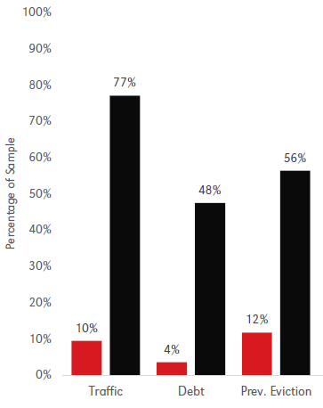
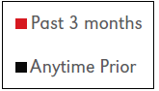
Our Results:
Prior Court Contacts

Slide 25
Our Results:
Prior Court Contacts
77% of people who had been evicted had previously been in traffic court.

Slide 26
Our Results:
Prior Court Contacts
48% of people who had been evicted had previously been in debt court.

Slide 27
Our Results:
Prior Court Contacts
56% of people who had been evicted had previously been in eviction court before.

Slide 28


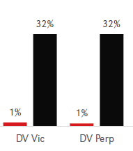
Our Results:
Eviction and DV
32% of people who had been evicted had previously been victims of domestic violence.

Slide 29
Our Results:
Eviction and DV
32% of people who been evicted had previously been perpetrators of domestic violence.

Slide 30
Key Findings
Domestic violence does overlap with eviction in meaningful ways, especially in the long-term.
People facing eviction have long histories of court contacts—most often for crimes of poverty.
These issues disproportionately impact women and Black residents of our city.

Slide 31
Recent Policy Changes
Reauthorization of Violence Against Women Act in 2022:
  Provides additional funding (including housing supports) to women victims of DV.
LB 320 in 2021:
  Allows victims of domestic violence to break lease early.
  Other protections for renters.

Slide 32
Where do we go from here?
We brought everyone together today to think about how local organizations can better acknowledge the connections between these issues.
We want to do some resource mapping and gap-identifying here today.

Slide 33
Resource Mapping
Using the Post-It Notes at your table, please complete the following:
Name of your organization and primary efforts to address housing insecurity, DV, or both.
When complete, place on the housing insecurity or DV panels in the room.

Slide 34
Identifying Strengths
What are some of the strengths of the Omaha community when it comes to addressing DV and housing insecurity?
Think, discuss with the table, and write your answer on a post-it note and place on the boards.

Slide 35
Identifying Gaps
What are some of the local gaps in addressing domestic violence, eviction, and the link between the two?
Think, discuss with the table, and write your answer on a post-it note and place on the boards.

Slide 36
In an Ideal World…
Think big. In an ideal world, how would we address housing insecurity and domestic violence locally—if you or your organization had unlimited resources?

Slide 37
Thank you!
We will be following up with an email that summarizes what we’ve put together today, including these slides.
We hope this has been valuable to you. Please stick around for conversation.
Thank you to Big Mama’s Kitchen and Catering and the Venue at the Highlander for hosting us!

