Slide 1


Assessing the Scope of Missing Native Americans in New Mexico: Results from a State-Wide Study
Tara Richards¹ and Emily Wright²
¹University of Nebraska Omaha
²Urban Institute, Justice Policy Center
Shaniya Decker
New Mexico Indian Affairs Department
Notes:
NOTES ABOUT THIS TEMPLATE
A design theme has been created for ease of use and consistency. Within the theme the background, font choice, and colors have been preset.
FONT: the font is set to Arial. Keep within this font family to ensure consistency within document and when opening on various computers.
COLORS: only use UNO designated colors which have been made into swatches and can be found under ”theme colors”
COPY: use textboxes to add copy to each new slide
LAST SLIDE: the last slide features the Lock-up and a combination of the Non-discrimination and accessibility statements. Please keep this at the end of your presentation in order to meet university brand policies.

Slide 2
Research reported in this presentation was sponsored by the National Institute of Justice under NIJ Grant Number 15PNIJ-22-GG-01625-REVA.
The conclusions expressed in this presentation are solely those of the presenters and do not necessarily reflect the views of the National Institute of Justice.

Slide 3
Missingness and Disparities in Native American Communities:
Social disparities and experiences with violence may contribute to an environment where individuals either intentionally or unintentionally “go missing”.
Native Americans have been subjected to genocide, colonization, and racism since the country’s inception (Deer, 2015).
Any study of Native American missing persons must be understood within this historical context, and the on-going structural inequalities and disparities that may make them more vulnerable to going missing.

Slide 4
Challenges to identifying # of missing persons:
The right to go missing among adults,
Whether “going missing” is a result of criminal or noncriminal behavior,
Lack of policies mandating the entry of missing persons into national data systems,
Lack of standardized definitions of missing persons, and
Variation in the age of what constitutes adult status across states and jurisdictions.

Slide 5
These challenges may be exacerbated among Native American missing persons, primarily due to:
  Complex jurisdictional issues
  Lack of coordination and relationships between tribal and non-tribal law enforcement agencies
  Racial (mis)classification when entering the cases into databases
  Tribal data sovereignty

Slide 6
Measuring “hidden populations” (e.g., missing persons) is inherently difficult.
There is no “standard” methodology to collect data or measure number of missing persons.
NIJ 2019-75-CX-0014 developed the “Nebraska Model” for counting missing persons.
  Point-in-time counts
  4 official sources of data (i.e., state clearinghouse, NCIC, NamUs, NCMEC) and cross check by tribal partner for unreported cases

Slide 7
Current Study
Replicate and extend Nebraska Model in New Mexico
Extended Model adds 3 data sources
  Navajo Nation List
  FBI Albuquerque field office list
  Open-source data

Slide 8
Research Questions
What is the scope of missing persons in New Mexico using the Nebraska Model (4 sources)?
What is the scope of missing persons in New Mexico using an Extended Model (7 sources)?
What is the scope and context of missing AI/AN persons in New Mexico?

Slide 9
Nebraska Model
Extended Model
Point-in-time counts of all missing persons from:
    New Mexico Clearinghouse (NMCH)
  National Missing and Unidentified Persons System (NamUs)
  National Center for Missing and Exploited Children (NCMEC)
  National Crime Information Center (NCIC) ​
  Point-in-time counts of all missing persons from:
    New Mexico Clearinghouse (NMCH)
    National Missing and Unidentified Persons System (NamUs)
    National Center for Missing and Exploited Children (NCMEC)
    National Crime Information Center (NCIC)
    Federal Bureau of Investigation Albuquerque (FBI)
    Navajo Nation
    Open Source

Slide 10
Methodology
  Point-in-time counts of all missing persons from: (1) New Mexico Clearinghouse (NMCH), (2) National Missing and Unidentified Persons System (NamUs), (3) National Center for Missing and Exploited Children’s (NCMEC), (4) the National Crime Information Center (NCIC), (5) Federal Bureau of Investigation Albuquerque (FBI), (6) Navajo Nation, and (7) Open Source
  Data were collected at 12 points-in-time – Time 1: May 17th, 2023 to Time 12: April 17th, 2024 (third Wednesday of each month)​
  Measures included name, sex, race, age at missing, date missing, reporting agency, and data source (e.g., NMCH) ​
Notes:
For each case, the first and last name, age at missing, sex (male/female), race (UCR racial categories: American Indian/Alaska Native, White, Black, Asian or Pacific Islander, or Unknown), and date of missingness was recorded. Whether the case was retrieved from the NMPL, NamUs, and/or NCMEC databases was also identified. Time missing was calculated by subtracting the date the person went missing from the date of data collection

Slide 11
Results: New Mexico's Reported Missing Person Cases

Slide 12
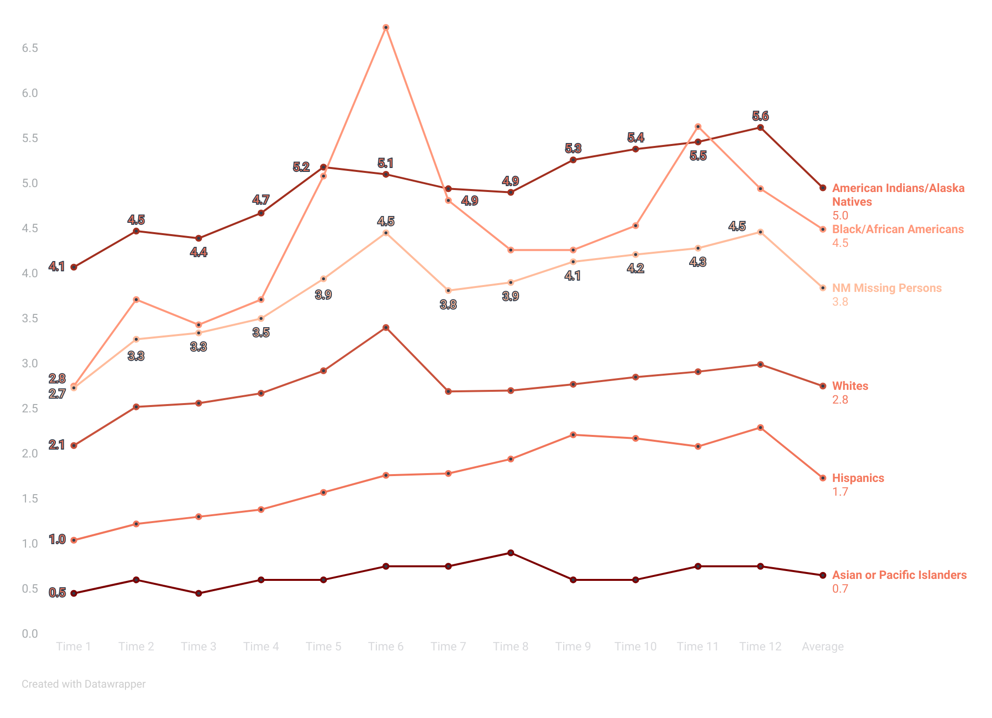
Figure 1: New Mexico’s Missing Persons Rates over Twelve Point in Time Counts
Using the Nebraska Model

Slide 13
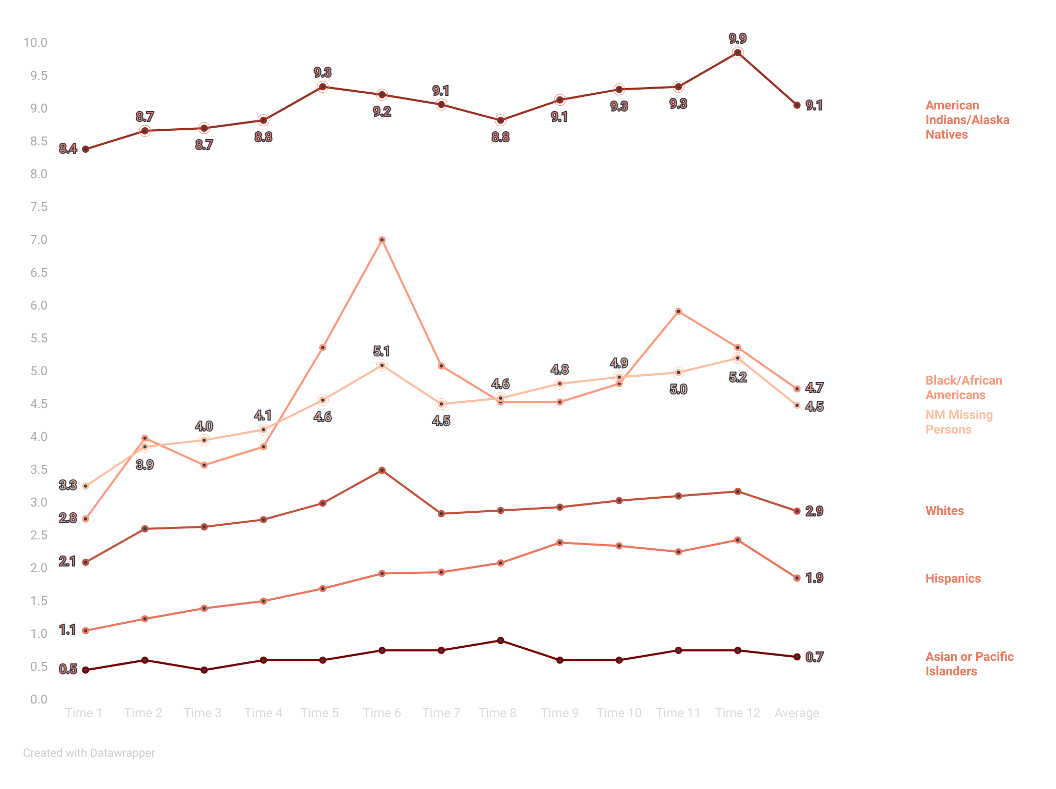
Figure 2: New Mexico’s Missing Persons Rates over Twelve Point in Time Counts
Using the Extended Model
Notes:
Nebraska model that uses 7 sources.
2023 census data. Rate calculation: # of missing person cases DIVIDED by the total number of people for that group. Multiply by 10,000 = rates.
NM overall missing persons rate: 3.3 per 10,000 New Mexicans at Time 1 to 5.2 per 10,000 at Time 12; average rate of 4.8 per 10,000 New Mexicans
Highest missing persons rate was for AI/AN persons: AI/AN persons were missing at 8.4 to 9.9 per 10,000 AI/AN persons in New Mexico; 9.1 per 10,000 AI/AN persons on average
Next highest missing persons rate was for Black/African Americans in New Mexico; average rate for Black/African Americans was 4.8 missing persons per 10,000 Black/African American persons in New Mexico

Slide 14
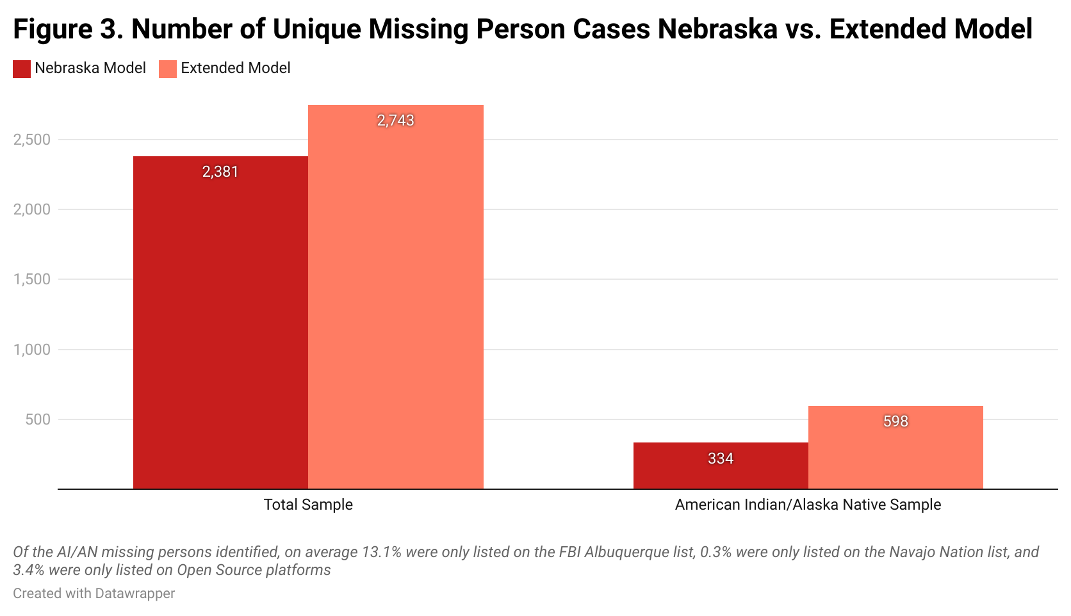
Findings: Nebraska Model vs. Extended Model

Slide 15
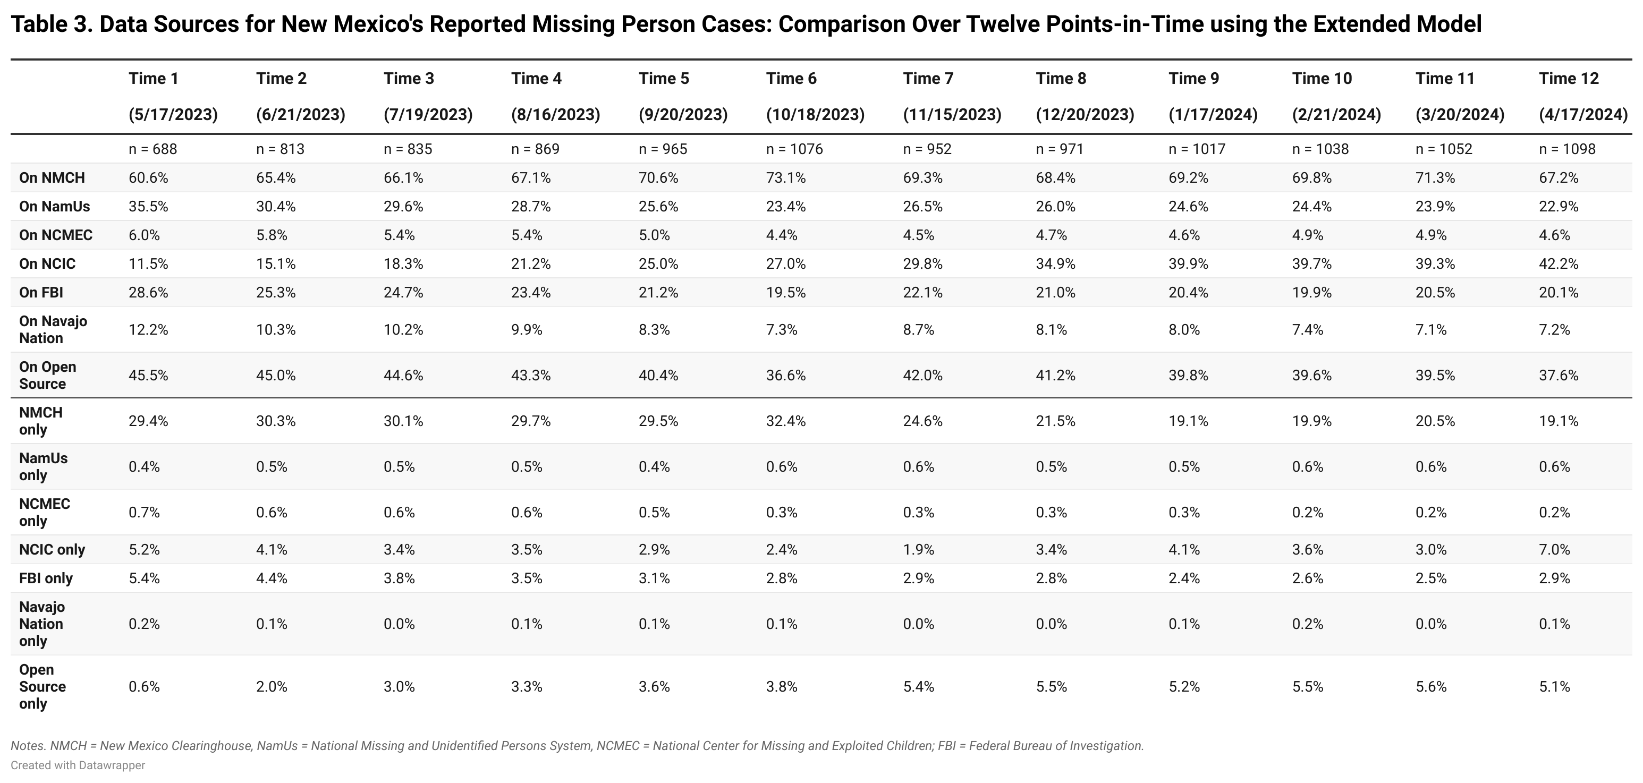

Slide 16
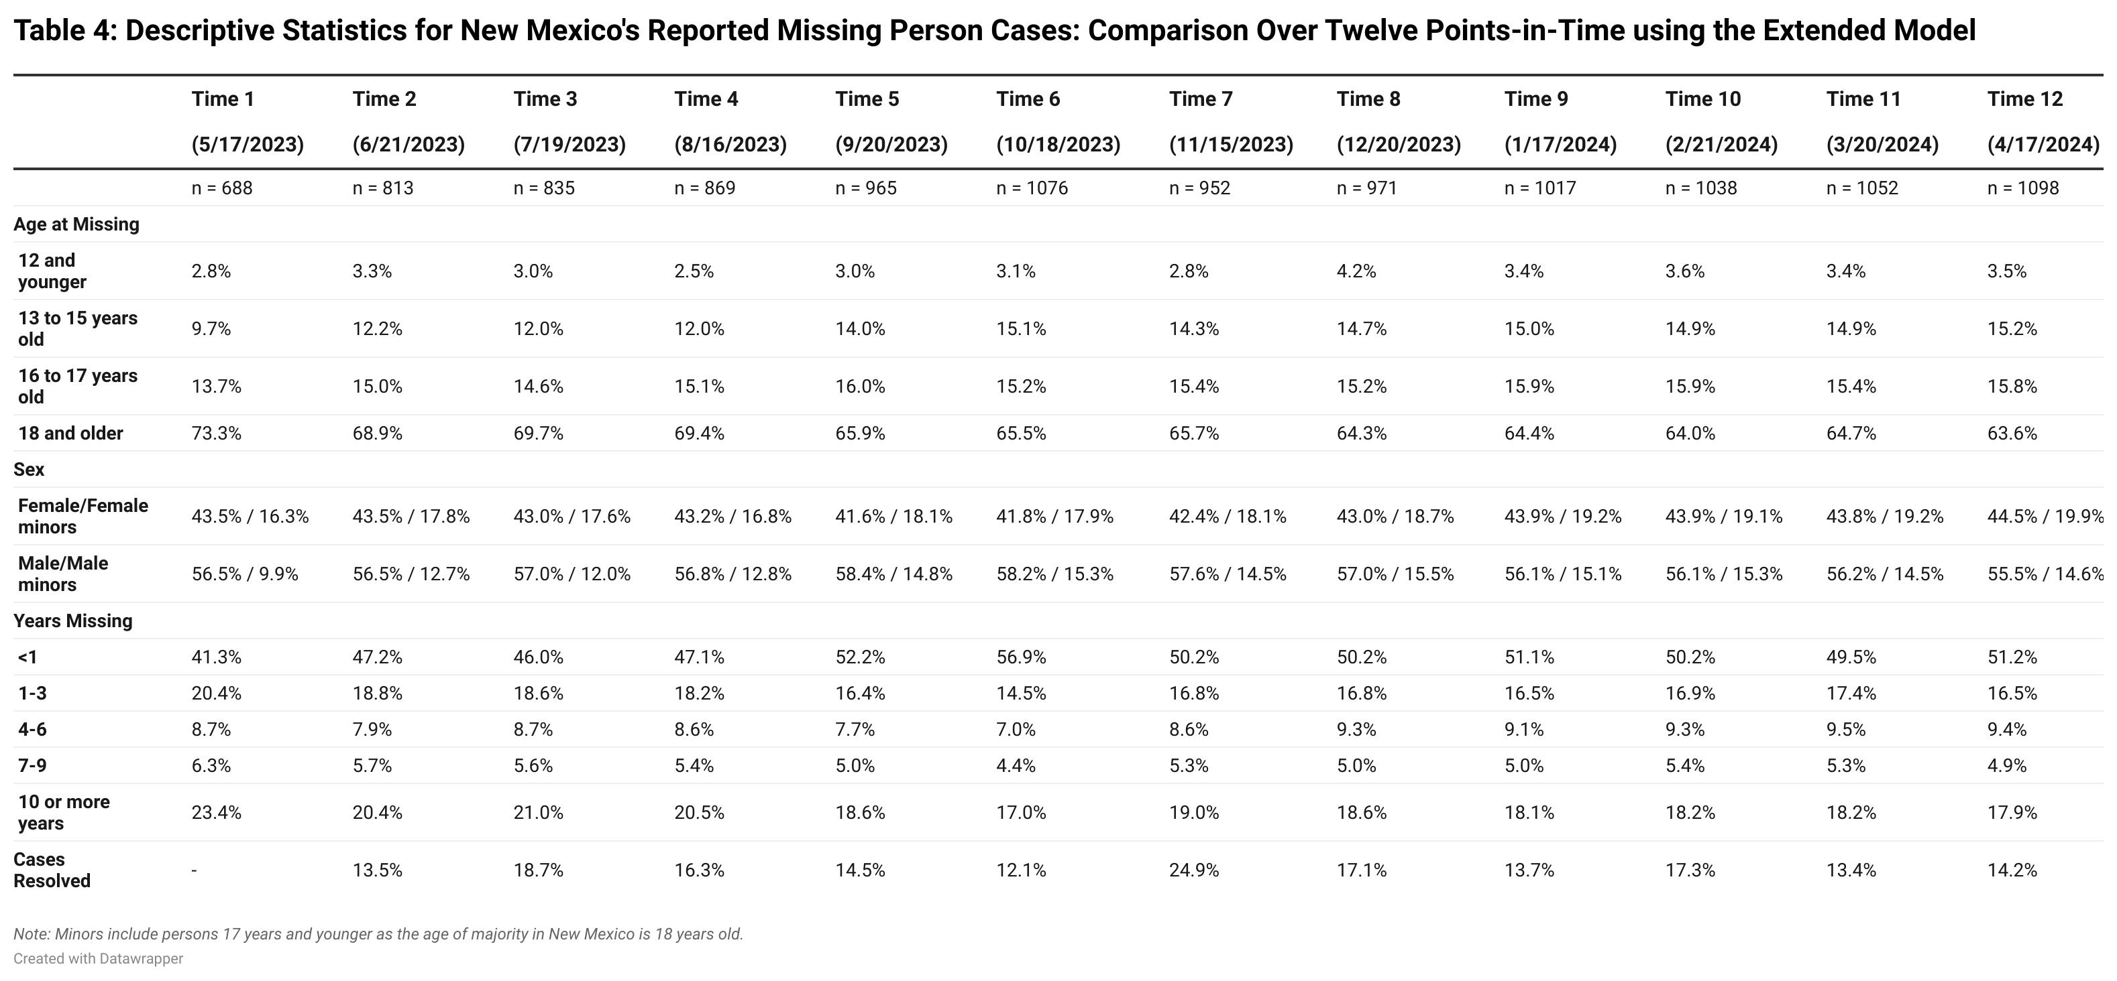

Slide 17
Results: New Mexico's Reported Missing Person Cases Involving AI/AN Persons

Slide 18
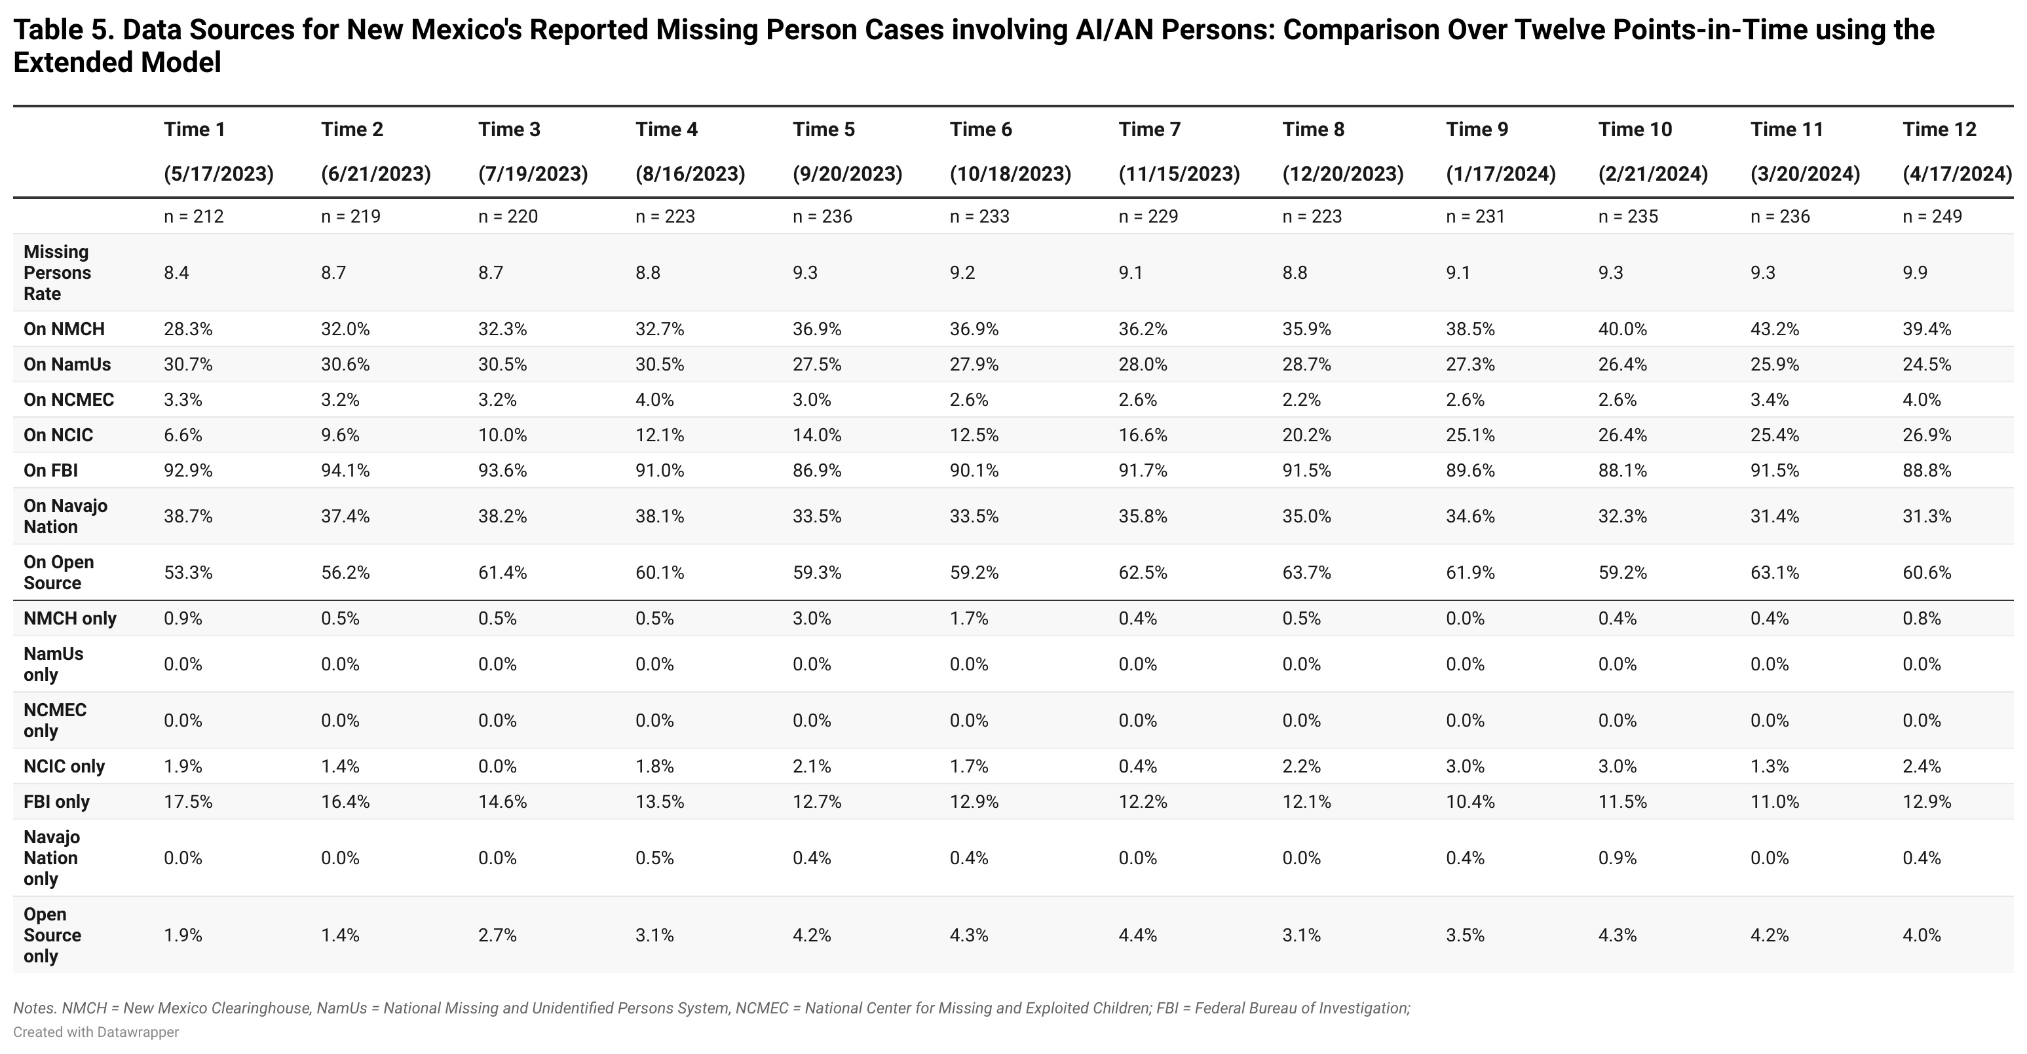

Slide 19
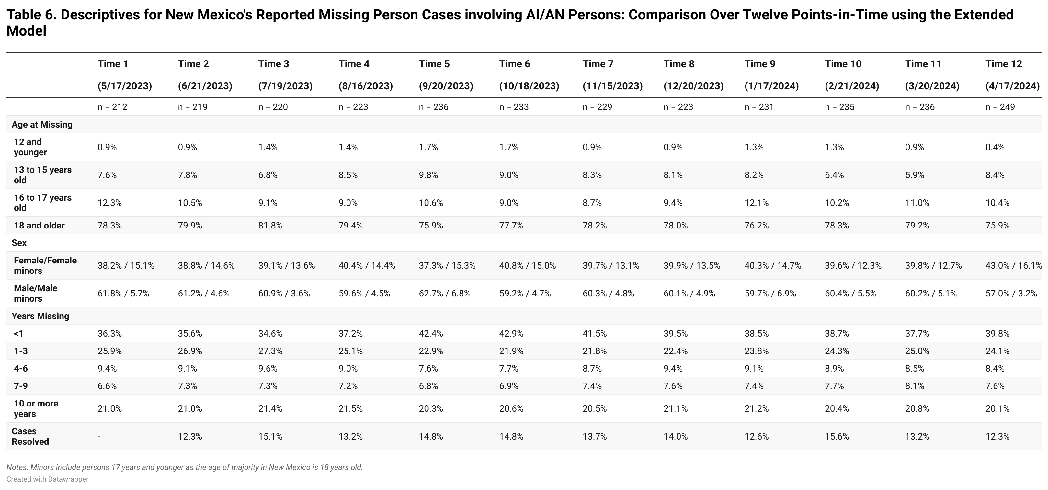

Slide 20
Findings: Scope/context of AI/AN missing persons in New Mexico
Most NM missing persons were White, but AI/AN and Black/African Americans were missing at disproportionate rates.
Most NM missing persons were listed on NMCH (67%), but many AI/AN missing persons were not listed on NMCH.
  Importance of FBI efforts, open source data
Most missing persons were males and adults – both overall and among AI/AN persons.
  Among AI/AN missing persons, female minors were missing at rates 2-3X that of male minors.
Case resolution was 19.4% on average overall, 13.8% for AI/AN missing persons.

Slide 21
Study Limitations:
Point-in-time counts, not all missing persons during 12 months
  does not reflect cases that were listed as missing, then taken down before the monthly collection dates
“Hidden figure” of unreported missing persons is simply unknown
The classification of race/ethnicity: Individuals may be misclassified regarding/race/ethnicity – 169 missing persons of “unknown” race

Slide 22
Conclusions/Future Analyses:
Importance of (1) using multiple missing persons data sources and (2) considering local, tribal context of missingness/data for missing person cases involving AI/AN persons
Further analysis will examine how cases were resolved – whether the missing person returned safely or not – as well as the circumstances of their going missing was not available
Focus group and interview data in progress

Slide 23
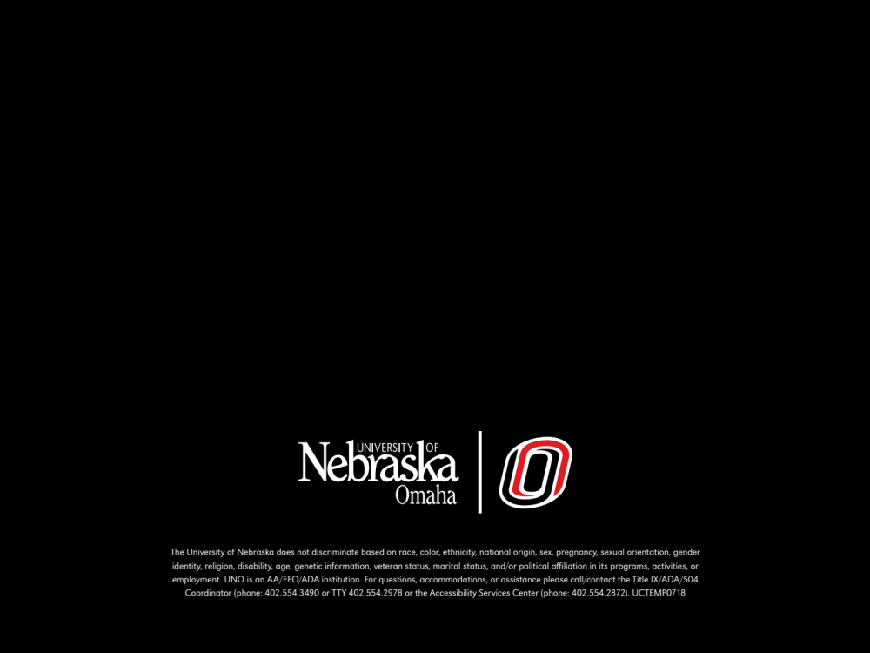
THANK YOU!
QUESTIONS/COMMENTS?
Tara Richards: Tararichards@unomaha.edu
Emily Wright: EWright@urban.org
Shaniya Decker: Shaniya.Decker@iad.nm.gov
Notes:
DO NOT DELETE THIS SLIDE. Please keep at the end of your presentation.

Slide 24
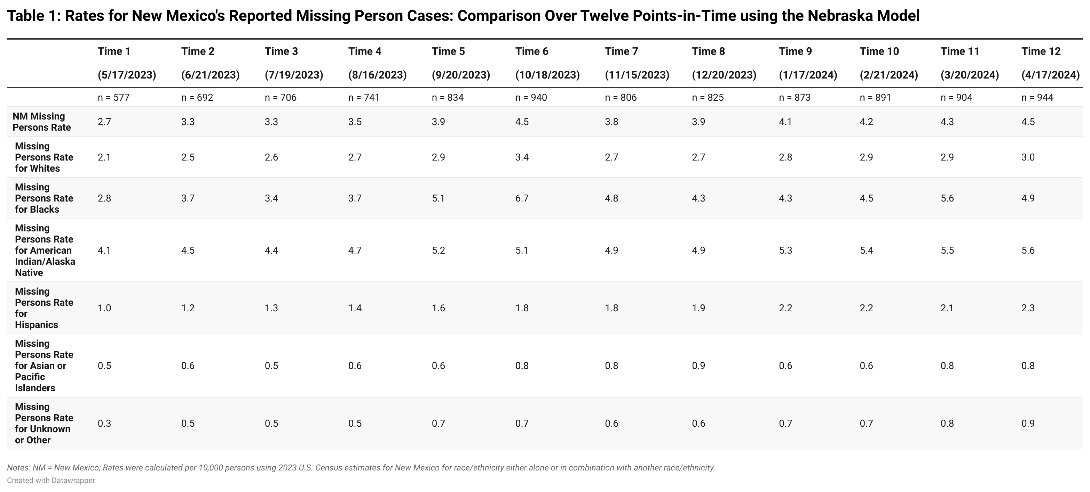
Notes:
Nebraska model that only uses 4 sources.
2023 census data. Rate calculation: # of missing person cases DIVIDED by the total number of people for that group. Multiply by 10,000 = rates.
NM overall rate: 2.7 per 10,000 people at Time 1 then 4.5 per 10,000 at Time 12
Largest missing persons rate is for Native people 4.1 to 5.6
Followed by Blacks
At time 1 we see that Native people were twice as much as White to go missing

Slide 25
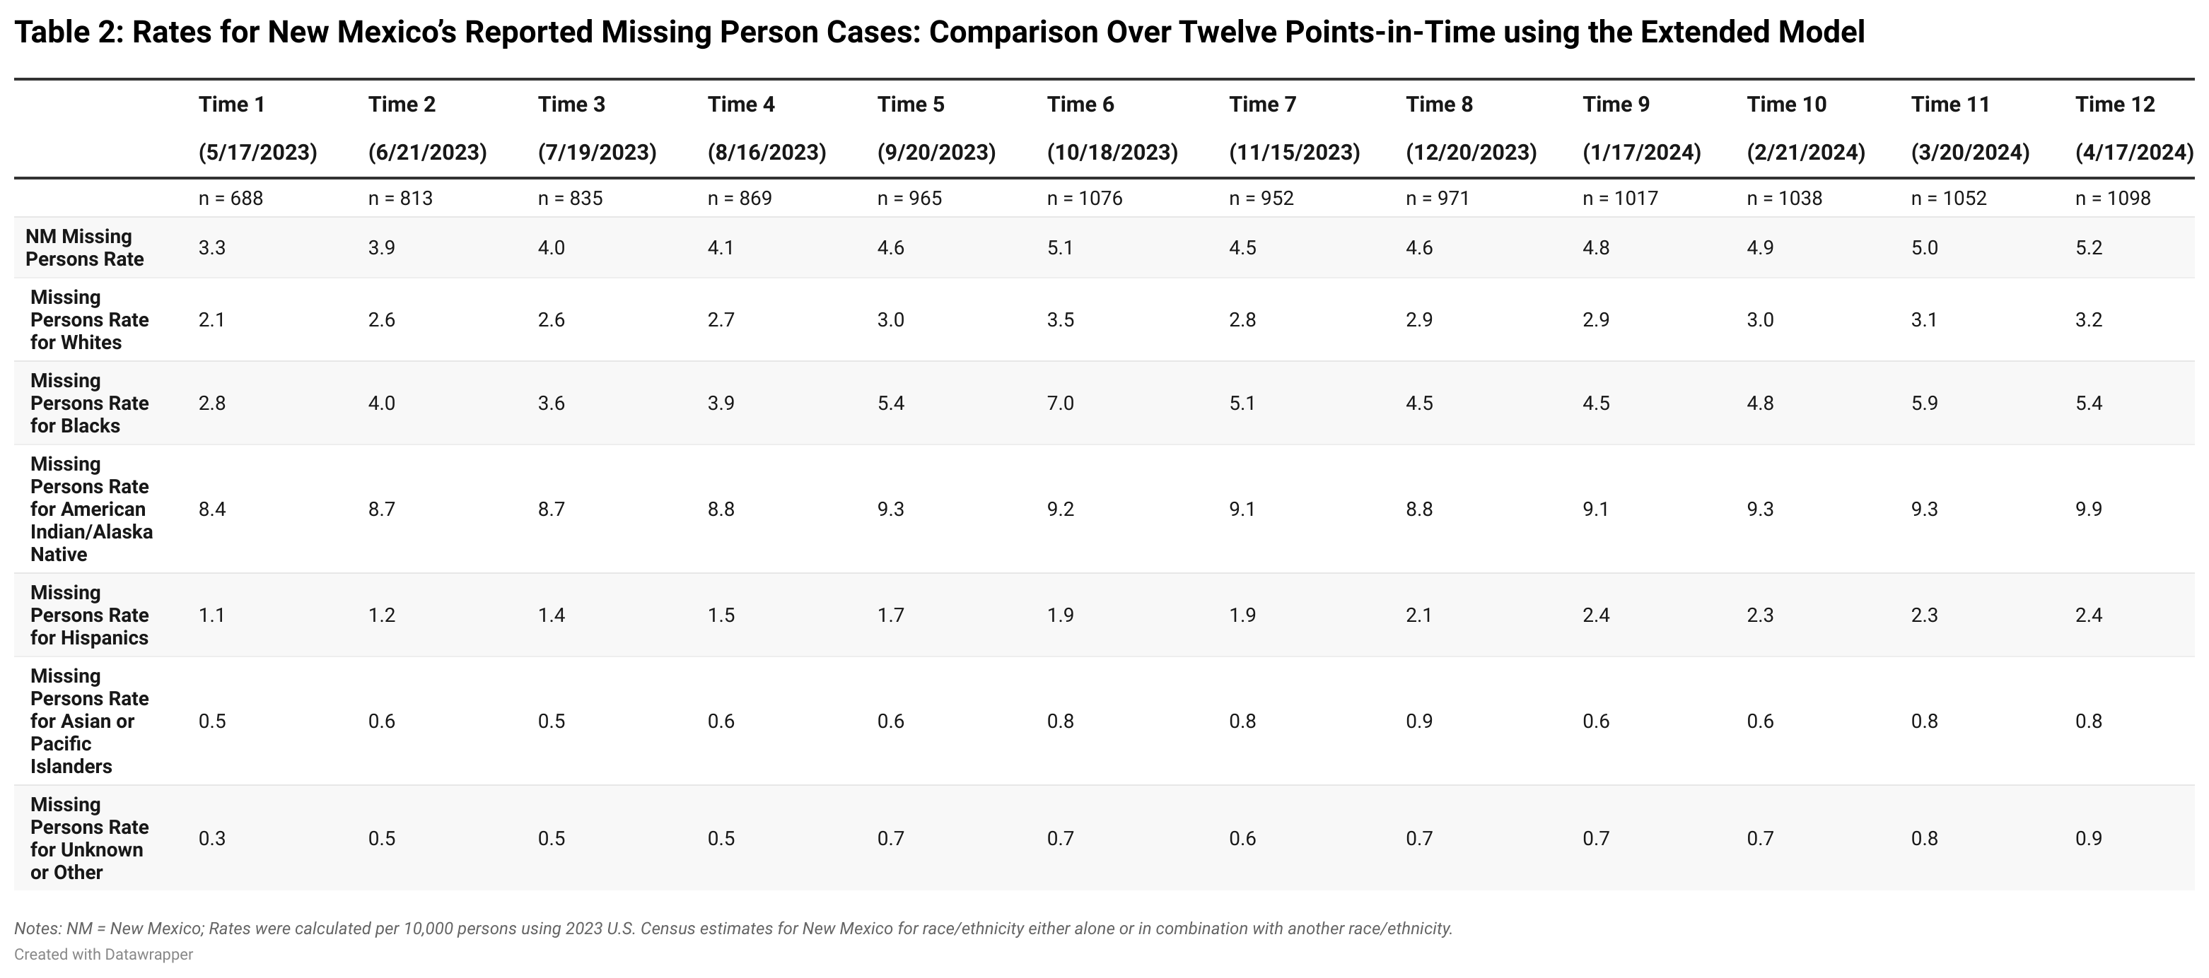
Notes:
Extended model with all 7 sources.
NM overall rate is 3.3 at Time1 and then 5.2 at Time 12
Again, Native people went missing at the highest rates from 8.4 at Time 1 to 9.9 at Time 12.
Including the 3 extra sources, Native people go missing at about 3-4x White people

